Slide 1
Local Gradient Hexa Pattern: A Descriptor for Face Recognition and Retrieval

Slide 2
The problem
Problem statement
Feature Descriptor
The original problem was that of the facial region identification and extraction of facial features (eye, nose, and mouth)
The proposed local gradient hexa pattern (LGHP) encodes the discriminative relationship among the reference pixel and its eight neighbors at different distances in four distinct derivative directions

Slide 3
Implementation

Slide 4

Four first-order directional derivatives (gradients) G1α,D of the image I(P) of size M×N in α=0∘,45∘,90∘ , and 135° directions at distance D for an arbitrary reference point P0 are computed as

Slide 5
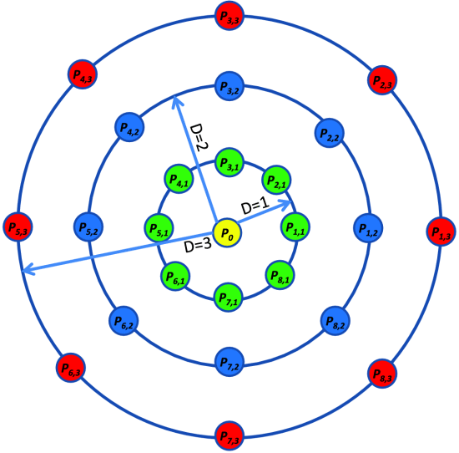

Slide 6

Second-order LGHP2α,β,D(.) at D distance is computed by encoding the pair-wise derivatives using encoding function C(.,.) and concatenating these encoded patterns. LGHP2α,β,D(.) is defined as

Slide 7

The encoding function C(.,.) for any point P in the derivative space is defined as

Slide 8

The encoding function C(.,.) for any point P in the derivative space is defined as

Slide 9
Original Image
6 | 8 | 5 | 9 | 1
2 | 8 | 7 | 6 | 5
3 | 4 | 1 | 8 | 7
5 | 6 | 2 | 3 | 4
3 | 5 | 7 | 8 | 2

Slide 10
G¹_{(0͒ ,1)}(P₀) = I(P₀) - I(P_{1,1})
-2 | 3 | -4 | 8 | 1
-6 | 1 | 1 | 1 | 5
-1 | 3 | -7 | 1 | 7
-1 | 4 | -1 | -1 | 4
-2 | -2 | -1 | 6 | 2

Slide 11
G¹_{(45° ,1)}(P₀) = I(P₀) - I(P_{2,1})
6 | 8 | 5 | 9 | 1
-6 | 3 | -2 | 5 | 5
-5 | -3 | -5 | 3 | 7
1 | 5 | -6 | -4 | 4
-3 | 3 | 4 | 4 | 2

Slide 12
G¹_{(90° ,1)}(P₀) = I(P₀) - I(P_{3,1})
6 | 8 | 5 | 9 | 1
-4 | 0 | 2 | -3 | 4
1 | -4 | -6 | 2 | 2
2 | 2 | 1 | -5 | -3
-2 | -1 | 5 | 5 | -2

Slide 13
G¹_{(135° ,1)}(P₀) = I(P₀) - I(P_{4,1})
6 | 8 | 5 | 9 | 1
2 | 2 | -1 | 1 | -4
3 | 2 | -7 | 1 | 1
5 | 3 | -2 | 2 | -4
3 | 0 | 1 | 6 | -1

Slide 14
G_{0°, 1} | -7 | 1 | 1 | 1 | 1 | 3 | 4 | -1 | -1
G_{45°, 1} | -5 | 3 | 5 | -2 | 3 | -3 | 5 | -6 | -4
LGHP²_{0°, 45°, 1} | 0 | 0 | 0 | 1 | 0 | 1 | 0 | 1 | 1
DECIMAL value = 43

Slide 15
G_{0°, 1} | -7 | 1 | 1 | 1 | 1 | 3 | 4 | -1 | -1
G_{90°, 1} | -6 | 2 | -3 | 2 | 0 | -4 | 2 | 1 | -5
LGHP²_{0°, 90°, 1} | 0 | 0 | 1 | 0 | 1 | 1 | 1 | 0 | 1
DECIMAL value = 93

Slide 16
The proposed LGHP depends on another parameter R∈[1,N] that specifies the upper limit of Dover which hexa patterns are computed.
Finally, second-order LGHP is computed as

Slide 17

LGHP encodes six binary patterns of 9 b each at a particular distance for different (α,β) pairs. These six patterns are converted to equivalent decimal values to generate six LGHP matrices. Spatial histograms of these six matrices are computed as
where HLGHPα,β,D is the histogram extracted from LGHP matrices corresponding to pairs different of α and β

Slide 18

L1 is used to measure the similarity between two histograms as it performs better than other measures on the data sets used in the experiments. Similarity measure SL1(.,.) is defined as
where SL1(X,Y) is the L1 distance computed on two vectors X=(x1,…,xq) and Y=(y1,…,yq) . Nearest one neighbor (1NN) classifier is used as used in [21] to compute the minimum L1 distance between the probe image and the gallery images, as similar regions of the probe and gallery images are effectively identified by 1NN classifier with optimal computational cost

